Slide 1
Thesis Defense: A new SCADA dataset for intrusion detection research
Ian Turnipseed

Slide 2
Introduction: What are SCADA systems?
Supervisory Control and Data Acquisition (SCADA) is a real-time system providing control to remote physical systems.
They also provide monitoring and visualization of these critical infrastructure systems.
Oil Refinement, Chemical Processing, Power Plants, Railroads, Water Treatment Facilities, HVAC, etc.
Notes:
SCADA systems collect data from remotes facilities about the state of the physical process and send commands to control the physical process creating a feedback control loop.

Slide 3
Typical SCADA topology
They are generally made up of four major components.
Sensing and Actuation
Programmable Logic Controllers (PLCs)
Communication Network
Human Machine Interface (HMI)

Slide 4
Security Issues with SCADA systems
Lack of authentication in communication protocols
Spoofing
Security through obscurity
Systems are specialized for certain application and cannot be understood unless in knowledge group
System is isolated physically
Since the systems are physically secure with locks and keys they cannot be tampered with
SCADA systems are also being interconnected with the Internet to allow for increased control and cost savings.

Slide 5


Motivation
Recent attacks on SCADA systems
Stuxnet
Davis-Besse Nuclear Plant
Maroochy, Australia
Flame
Aurora
Notes:
There have been several real-world documented incidents and cyber-attacks affecting SCADA systems, which clearly illustrate critical infrastructure vulnerabilities. These reported incidents demonstrate that cyber-attacks on SCADA systems might produce a variety of financial damage and harmful events to humans and their environment. The Stuxnet worm targeted industrial control systems and altered system behavior at the client and server level. This worm affected uranium enrichment plants in Iran and was able to collect surveillance data. It could also cause the system to be placed in a critical state which could cause harm to human lives. A disgruntled engineer penetrated a sewage control system in Maroochi Australia and caused approximately 264,000 gallons of raw sewage leak in to nearby rivers. In 2003, the Davis-Besse nuclear plant in Oak Harbor Ohio was attacked by the Slammer Worm which caused a safety monitoring system of the plant to go offline for approximately five hours

Slide 6
Motivation
Intrusion Detection System (IDS) researchers require tools and data to further their research in preventing these attacks
Datasets are commonly used to train and test classifiers to detect various types of attacks
1999 DARPA dataset [1]
Currently, no commonly shared datasets exist for SCADA systems
Comparison of IDS solutions is difficult
Third-party validation of IDSs is difficult
Not all categories of attacks are included in each individual dataset
Notes:
The 1999 DARPA dataset produced by MIT’s Lincoln Labs was created with the intent for researchers to test viable Intrusion Detection Systems (IDS) for effectiveness. The dataset has been a vital part in furthering research for evaluating computer network IDSs and providing a benchmark for other researchers to compare and validate results, but the dataset was found to contain unintended patterns that led algorithms to easily learn differences between scenarios.

Slide 7
Motivation
System Name | Publish Year | Detection Principle | Threat Model
Fixed-Width Clustering [2] | 2014 | Anomaly | None, only real world faults if any
Self-Organizing Maps [3] | 2009 | Anomaly | Not Specified
SCADA Testbed [4] | 2009 | Anomaly | Not provided, created by user of testbed
Model-Based Intrusion [5] | 2007 | Anomaly | Reconnaissance Only
AAKR [6] | 2006 | Anomaly | Denial of Service and Injection

Slide 8
Research Problem
Previous Work
A former PhD student under Dr. Morris collected data from MSU’s gas pipeline SCADA system
Traffic between the Master Terminal Unit (MTU) and the slave Remote Terminal Unit (RTU) was recorded in a Comma- Separated Values (CSV) file
He created 28 attacks/anomalies against the gas pipeline

Slide 9
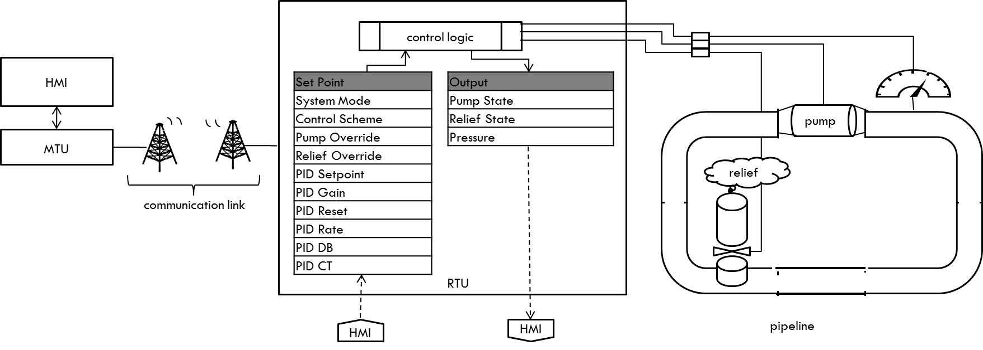
Gas Pipeline

Slide 10
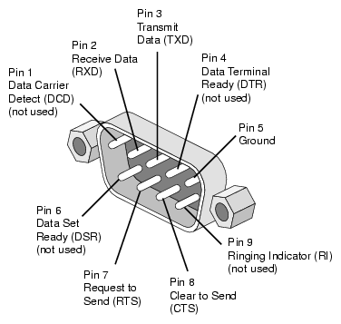
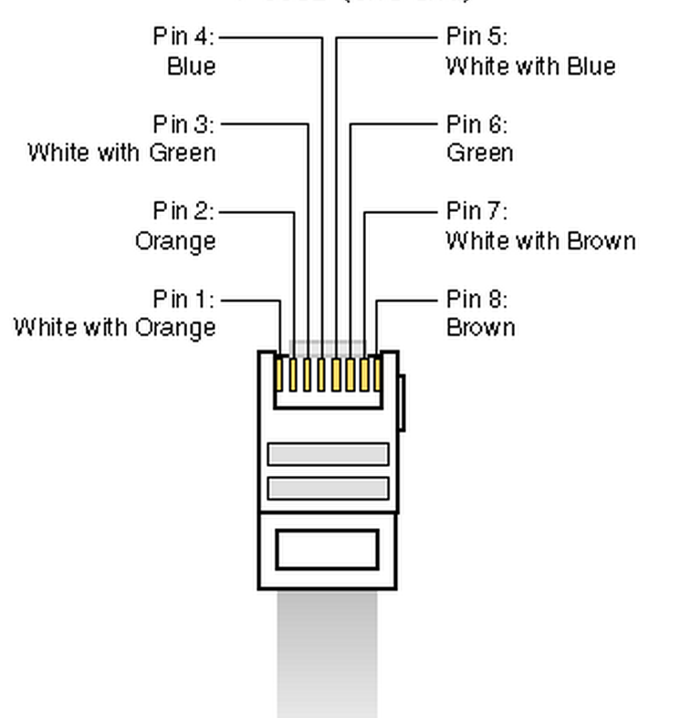
MODBUS Protocol
This protocol is used on many Industrial Control Systems (ICSs), specifically SCADA systems
Master/Slave Configuration
Similar to client/server except slave does not request data, it only receives commands from master
Transmitted over serial lines (Modbus RTU/ASCII) or over Ethernet (Modbus TCP)
Notes:
SCADA systems have very regular communication patterns. Often the same limited set of read and write commands will be repeated in a loop. For example, the gas pipeline system used for this work repeats the same two commands in a loop. First, it writes the contents of all registers and coils used for control. Next, a Modbus read holding register command is used to read the measured state of the system. These two commands are each followed by a response. This regularity leads to a set of commands in which all device addresses are constant, each of the 4 packets always have the same length, and each of the 4 packets always have the same function code. This lack of variation is expected. These regular patterns can be exploited by machine learning algorithms which build a model of normal behavior and detect abnormal deviations.

Slide 11
Research Problem
Previous Work
Machine learning algorithms were used to analyze the datasets (Zac Thornton, David Mudd, and Jeff Hsu in the summer of 2014)
The algorithms detected the attacks/anomalies with ease (98%-100%)
Further breakdown showed that there was not enough randomness among normal/attack scenarios

Slide 12
Research Problem
How can I create a dataset which limits these patterns?
New Framework
Randomize normal modes
Auto IT Script to simulate real operator activity
Randomize which attacks to execute
Parameterize the attacks
Create new attacks
Label the datasets with more detailed signatures
Provide raw data along with preprocessed data

Slide 13
Research Contribution
This research contributes two datasets which have been introduced to replace the previous dataset that was deemed unsuitable for IDS research
The research also presents an automated framework to simulate normal and attack scenarios.

Slide 14
Research Contribution
The datasets are in the form of a CSV(Comma separated values) file
The Raw dataset contains the whole Modbus frame
Third-party validation of preprocessed ARFF dataset
Allows researchers to use specialized preprocessing techniques
The ARFF dataset contains deep packet inspection of the Modbus frame
To be used with WEKA
Previous dataset combined four network transactions into one line of the dataset
Each line in the new dataset represents one network transaction
Notes:
WEKA

Slide 15
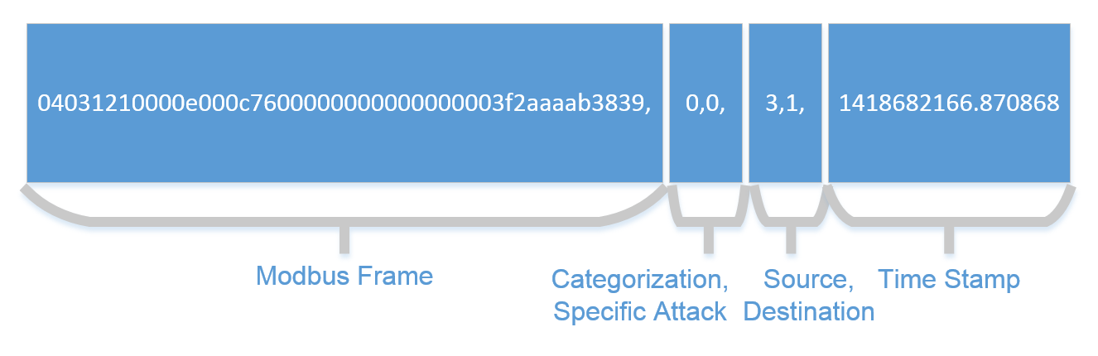
Raw Dataset
The Raw dataset contains 6 different features

Slide 16
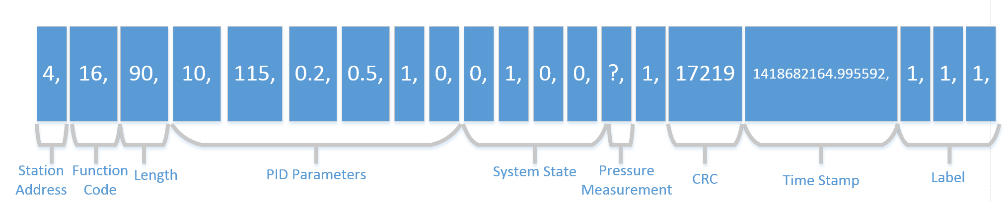
ARFF Dataset
The ARFF dataset contains 20 different features

Slide 17
ARFF Feature List
Feature | Type
address | Network
function | Command Payload
length | Network
setpoint | Command Payload
gain | Command Payload
reset rate | Command Payload
deadband | Command Payload
cycle time | Command Payload
rate | Command Payload
system mode | Command Payload
control scheme | Command Payload
pump | Command Payload
solenoid | Command Payload
pressure measurement | Response Payload
crc rate | Network
command response | Network
time | Network
binary attack | Label
categorized attack | Label
specific attack | Label
The datasets contain network transactions captured over a serial line
Network information
Time stamp, Station address, CRC, etc.
Payload information
System control and state information
Label
Binary / Category / Specific mode identifier
Deep packet inspection provides system state information
Pressure measurements, pump state, solenoid state, etc.

Slide 18
Gas Pipeline Datasets
The new datasets contain examples of both normal activity, as well as 35 different attacks.
The normal scenarios are controlled by an Auto IT Script
The attack scenarios are randomly chosen and most originated from Gao’s research
They are categorized into seven categories shown in the table below.
Type of Attacks | Abbreviation
Normal | Normal(0)
Naïve Malicious Response Injection | NMRI(1)
Complex Malicious Response Injection | CMRI(2)
Malicious State Command Injection | MSCI(3)
Malicious Parameter Command Injection | MPCI(4)
Malicious Function Code Injection | MFCI(5)
Denial of Service | DOS(6)
Reconnaissance | Recon(7)

Slide 19
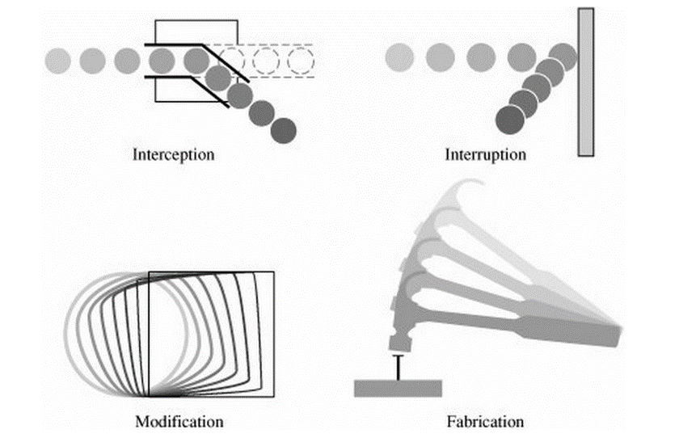
Attacks on Gas Pipeline
The 7 categories of attacks executed against the system include all 4 types of attacks.
This is missing in many datasets which are used in IDS research
[7]

Slide 20
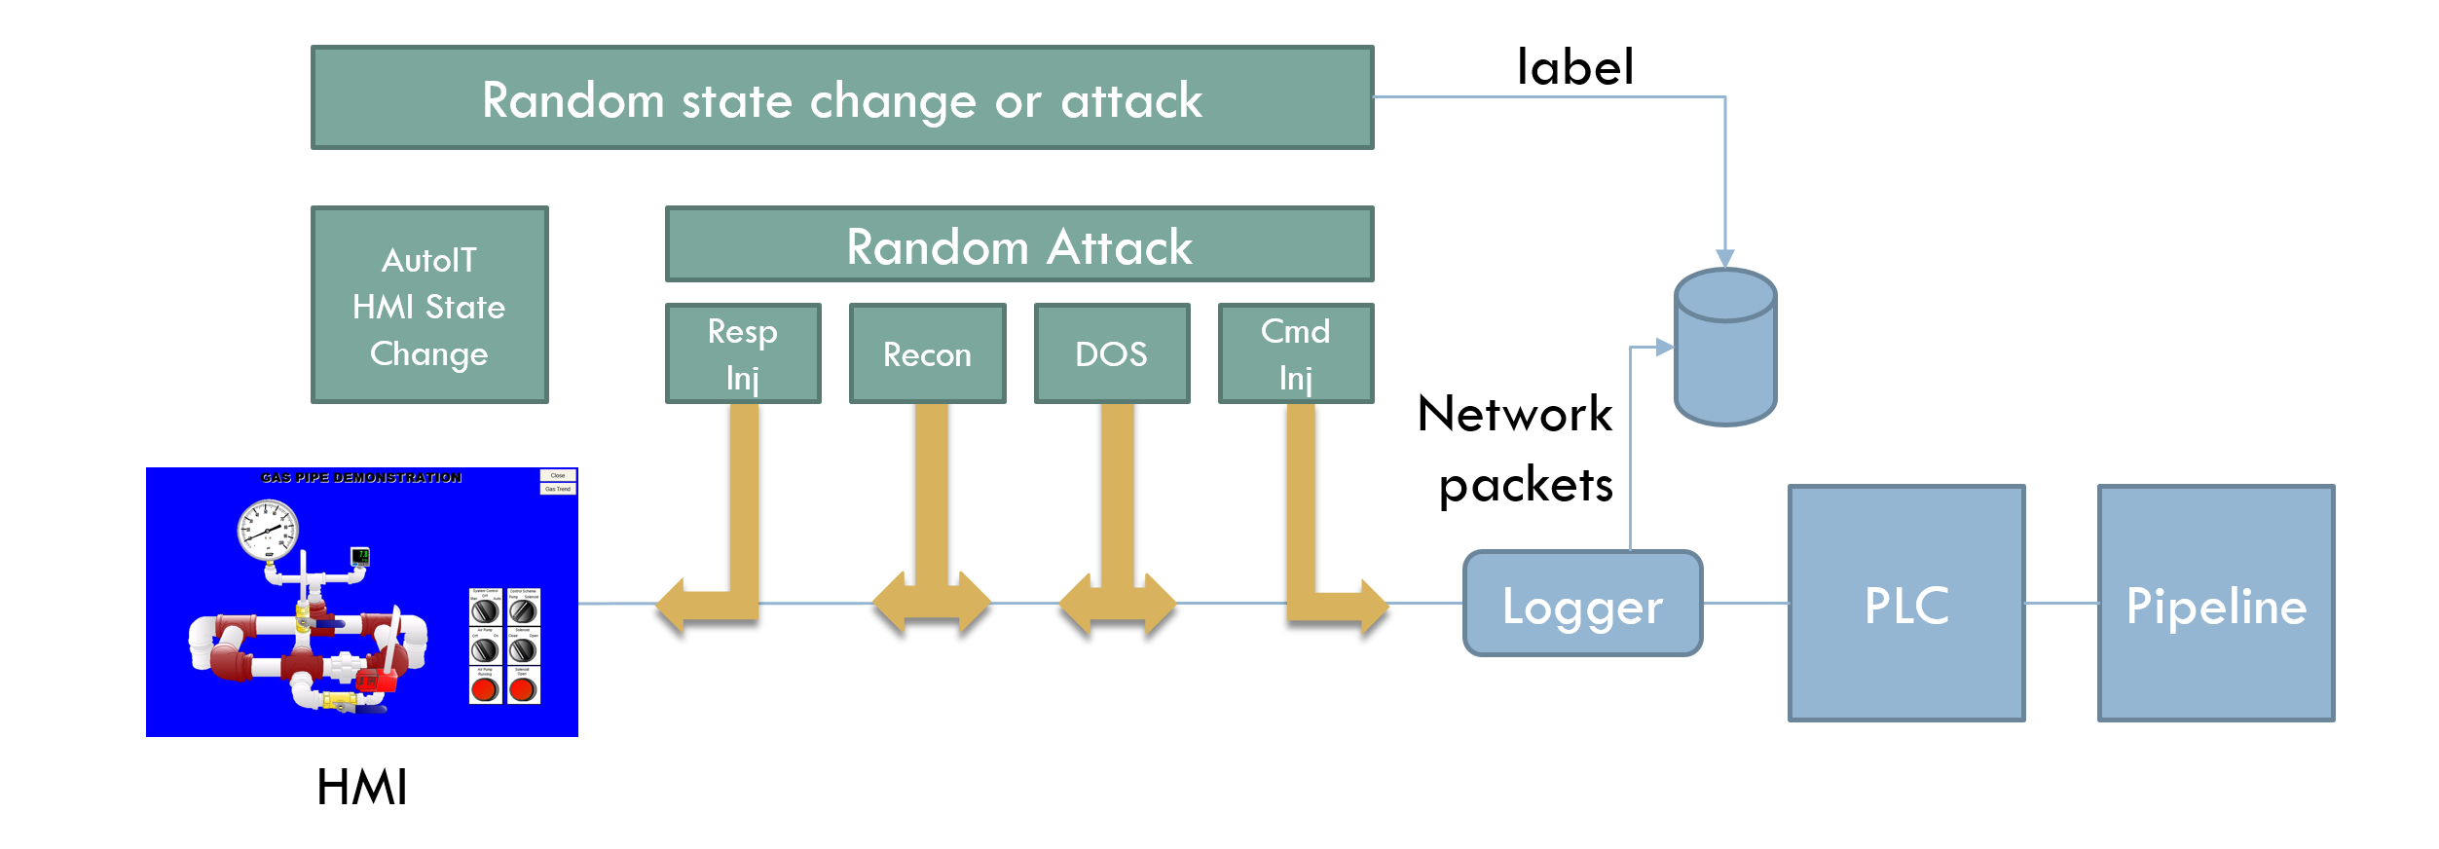
Dataset Collection Framework
Randomly chooses attack or normal operation
If normal, randomly chooses state/parameter values
If attack, randomly chooses between the 35 different attacks
Duty Cycle of 25.9%
Physical constraints of gas pipeline (I broke 3 pumps ☹)

Slide 21
How Do I Know the Dataset Improved?
By following the methodologies from Thornton et al’s report
Algorithm performance was measured
Individual analysis on each feature was conducted
The dataset shows less obvious correlations between feature and attack pattern

Slide 22
Problems with Previous Dataset
command_address
Always 4, unless DOS attack
reponse_address
always 19 unless Recon attack
comm_read_function
always 3 unless DOS attack
resp_read_fun
only 1 when normal or CMRI attack
subfunction
always 0 unless MFCI attack
response_length
Always 19 unless a recon attack
setpoint
always 20 unless MPCI attack
control_mode
only 1 when MSCI
control scheme
only 0 when MSCI
measurement
All CMRIs in range 6-11
All NMRIs grossly out of bounds

Slide 23
Algorithm Selection
Datasets were run through a subset of algorithms chosen from Thornton et al’s report.
Algorithms | Category
Naïve Bayesian Network | Bayes
PART | Rule-Based
Multilayer Perceptron | Neural Network

Slide 24
Results from Algorithms
Since the system is now placed into all possible normal conditions, the algorithms is forced to differentiate between multiple normal conditions
Further analysis was conducted using the PART algorithm.
Algorithm | New Dataset Classification Accuracy | Gao’s Dataset Classification Accuracy
Naïve Bayesian Network | 80.39% | 98.5%
PART | 94.14% | 99.32%
Multilayer Perceptron | 85.22% | 100%

Slide 25
Normal vs attack traffic
Dataset | Percentage of Attack Instances | Percentage of Normal Instances
New Dataset | 21.9% | 78.1%
Gao’s Dataset | 37.1% | 62.8%
94% may seem to be a high accuracy rate, but if I were to assign all instances to be normal I would have an accuracy of 78.1%.
The false positive rates highlight the inaccuracies found in the new dataset.

Slide 26
False Positive Rates
Further analysis was conducted using the PART rule-based algorithm to inspect exactly which categories of attacks were not detected in the new dataset versus Gao’s dataset
Category | New Dataset FP (%) | Gao’s Dataset FP (%)
Normal | 20.7% | 1.1%
NMRI | .8% | 0%
CMRI | .5% | .1%
MSCI | 0% | 0%
MPCI | 0% | .2%
MFCI | 0% | 0%
DoS | 0% | 0%
Recon | 0% | 0%

Slide 27
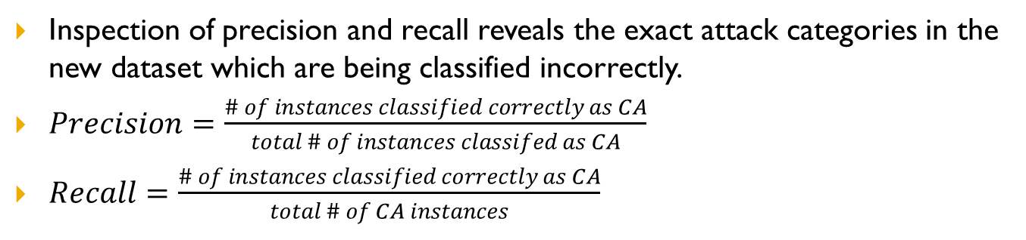
Precision and Recall
Inspection of precision and recall reveals the exact attack categories in the new dataset which are being classified incorrectly.
$Precision=\frac{\# of instances classified correctly as CA}{total \# of instances classifed as CA}$
$Recall=\frac{\# of instances classified correctly as CA}{total \# of CA instances}$
 | New Dataset |  | Gao’s Dataset
Category | Precision | Recall | Precision | Recall
Normal | 94.5% | 99.9% | 99.4% | 99.5%
NMRI | 74.2% | 82.4% | 99.5% | 94.4%
CMRI | 89.3% | 82.1% | 99.4% | 99.9%
MSCI | 99.3% | 54.9% | 97.4% | 95.1%
MPCI | 99.8% | 63.9% | 97.5% | 98.0%
MFCI | 98.6% | 100.0% | 100.0% | 95.8%
DoS | 99.6% | 48.3% | 99.8% | 97.9%
Recon | 100.0% | 97.1% | 100.0% | 100.0%
CA = Category of Attack

Slide 28
Precision and Recall
The precision and recall for all attack categories in the Gao dataset are high.
Thus the PART algorithm was successful at detecting all normal and attack scenarios in the Gao dataset.
The low precision (74.2% and 89.3%) for NMRI and CMRI lies in the PART algorithms fault in differentiating between the two.
Randomness of NMRI may overlap with a CMRI attack
Low recall (63.9% and 54.9%) in MPCI and MSCI are a direct result of the new attack framework.
More coverage of states and parameters in dataset

Slide 29
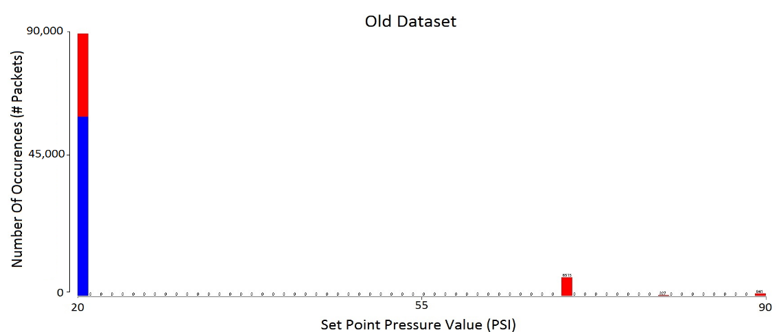
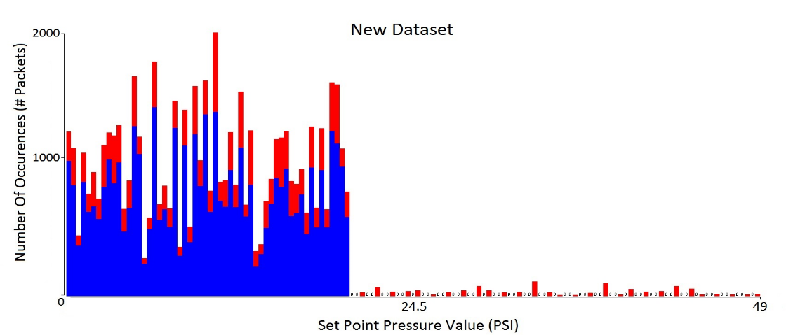
MPCI: Setpoint Coverage Comparison
setpoint
always 20 unless MPCI attack

Slide 30
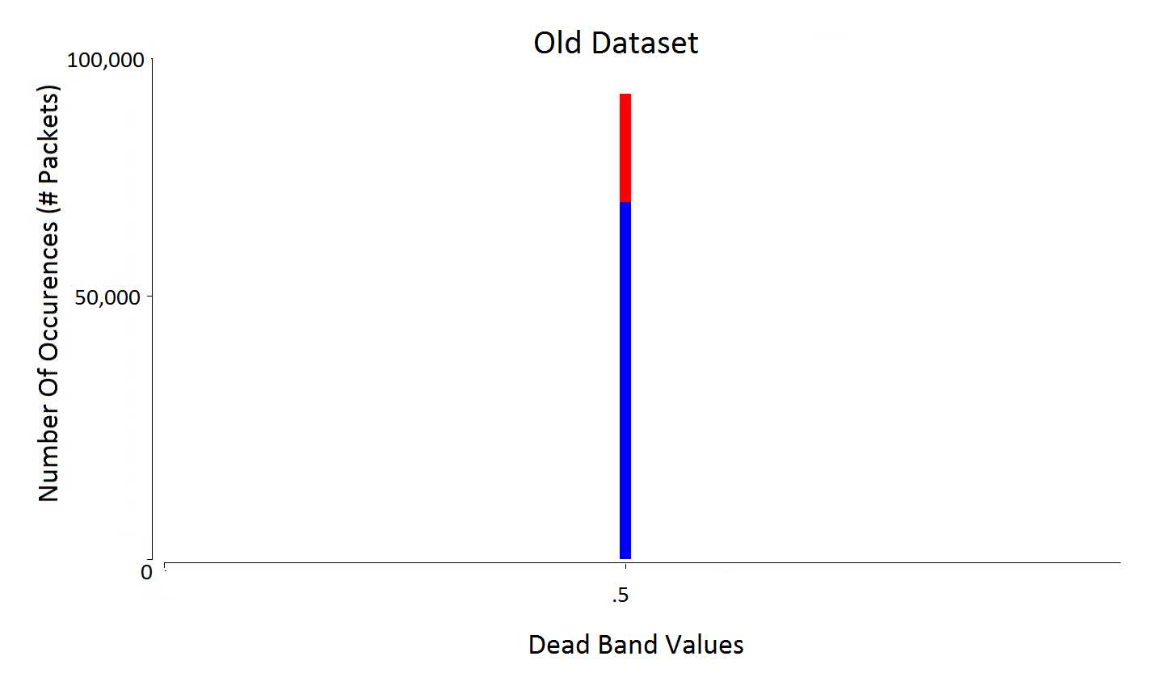
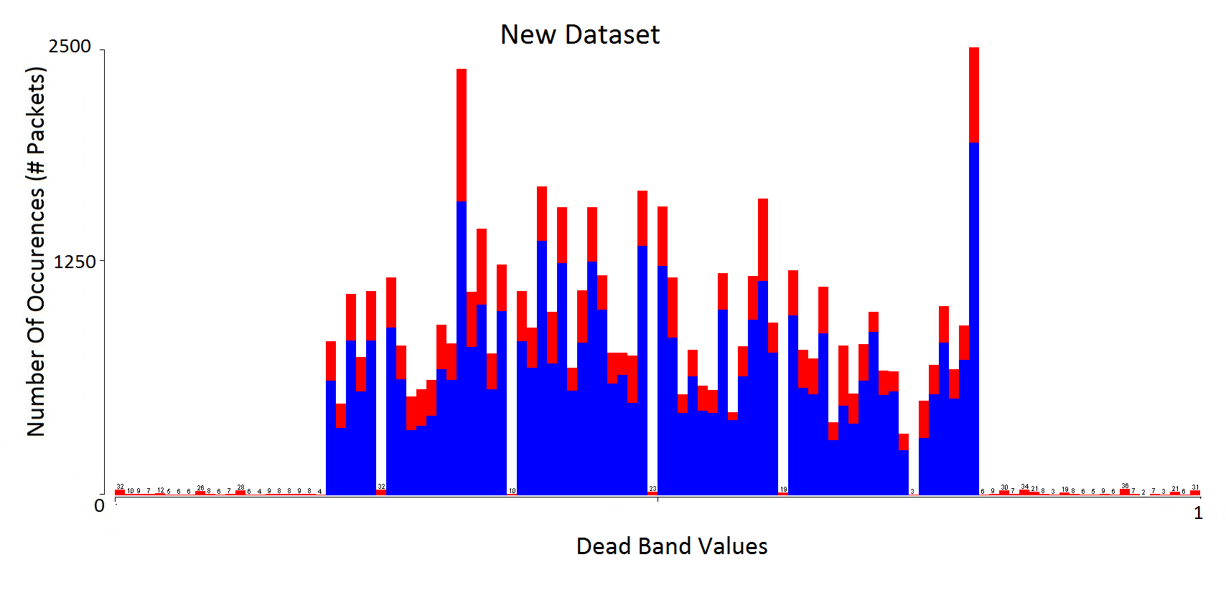
MPCI: PID DB Coverage Comparison

Slide 31
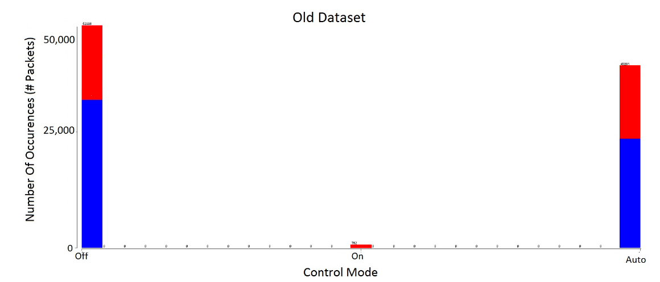
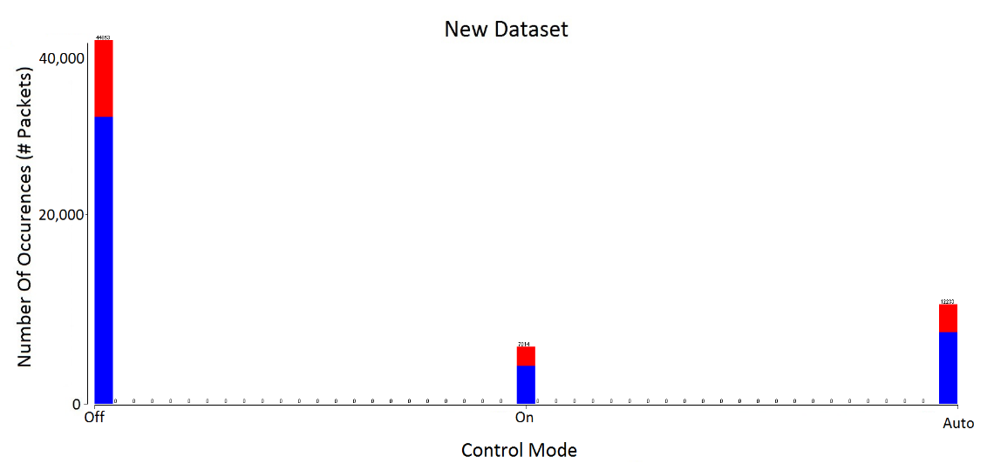
MSCI: System Control Mode Coverage
control_mode
only 1 when MSCI

Slide 32
Attack Patterns to Features
There are still some correlations between features and attack patterns, but these are inherent to the behavior in the system.
Thus, the MLAs should utilize these features to detect attacks which change these parameters.
Feature | Address | Length | Function | Measurement
Easily Detected Attack | Recon/ DOS | Recon | MFCI | NMRI
The Function Field was not even needed to detect Function Code Scan Attack (Recon)

Slide 33
Conclusions
SCADA systems are becoming more vulnerable to outsider threats with increased network connectivity. The need for industrial control system IDS research is increasing.
A new methodology for implementing attacks and a simulated operator have been implemented to create these data logs.
The datasets proposed in this thesis have improved from the previous iteration and are suitable for IDS research.

Slide 34
Future Work
Expand to a multi-node system
There is still room for more attacks to be created
More behavioral attacks which spread across multiple features
Distribute dataset to researchers in SCADA IDS field
Develop IDSs tailored for this application

Slide 35
References
[1] K. Da 2000. Attack development for intrusion detection. Master’s Thesis. Massachusetts Institute of Technology, Cambridge, MA.
[2] A. Almalawi, X. Yu, Z. Tari, A. Fahad, I. Khalil, “An unsupervised anomaly-based detection approach for integrity attacks on SCADA systems”, Computers & Security, Volume 46, October 2014, Pages 94-110, ISSN 0167-4048,
[3] J.M. Moya; Á. Araujo; Z. Banković; J.-M.De Goyeneche.; J.C. Vallejo; Malagón, P.; D. Villanueva; D. Fraga; E. Romero; J. Blesa, Improving Security for SCADA Sensor Networks with Reputation Systems and Self-Organizing Maps. Sensors 2009, 9, 9380-9397.
[4] A. Mahmood; H. Jianku; Z. Tari,;Y. Xinghuo; , "Building a SCADA Security Testbed," Network and System Security, 2009. NSS '09. Third International Conference on , vol., no., pp.357-364, 19-21 Oct. 2009
[5] S. Cheung et al. "Using model-based intrusion detection for SCADA networks." Proceedings of the SCADA security scientific symposium. Vol. 46. 2007.
[6] D. Yang, A. Usynin, and J. Wesley Hines. "Anomaly-based intrusion detection for SCADA systems." 5th intl. topical meeting on nuclear plant instrumentation, control and human machine interface technologies (npic&hmit 05). 2006.
[7] "Cryptography and Security in Computing." (2012): n. pag. Tech Target. Web.

Slide 36

Questions/Comments?

